Slide 1
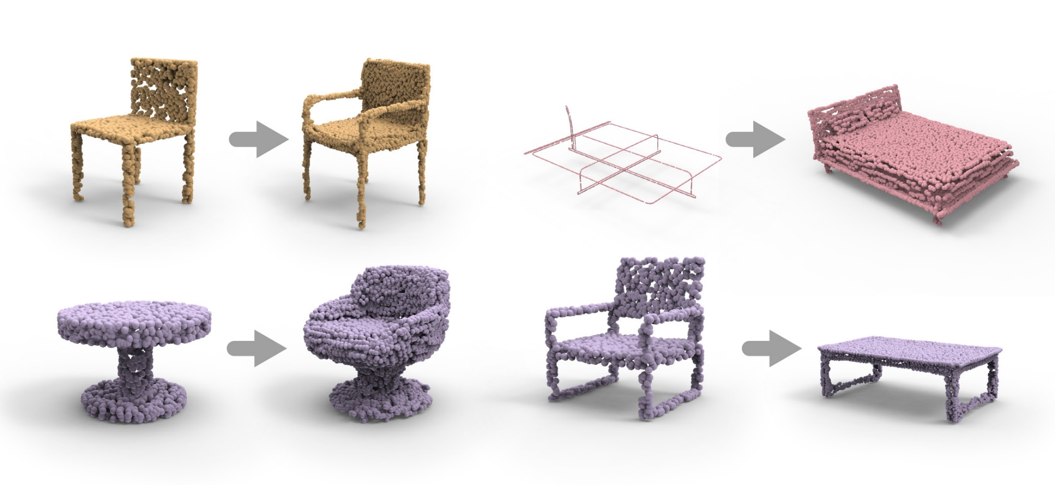
LOGAN: Unpaired Shape Transform in Latent Overcomplete Space
Kangxue Yin, Simon Fraser University
Zhiqin Chen, Simon Fraser University
Hui Huang, Shenzhen University
Daniel Cohen-Or, Tel Aviv University
Hao(Richard) Zhang, Simon Fraser University
Notes:
Thanks for the introduction.
The work is about learning shape transform between two unpaired domains.

Slide 2
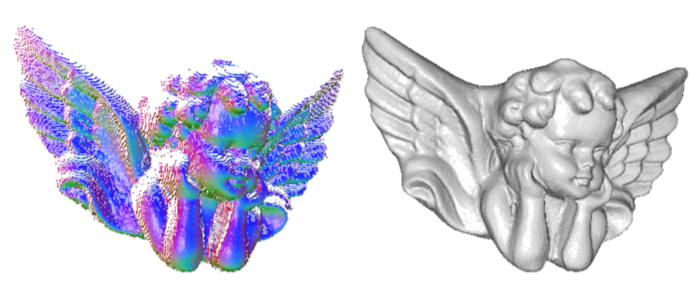
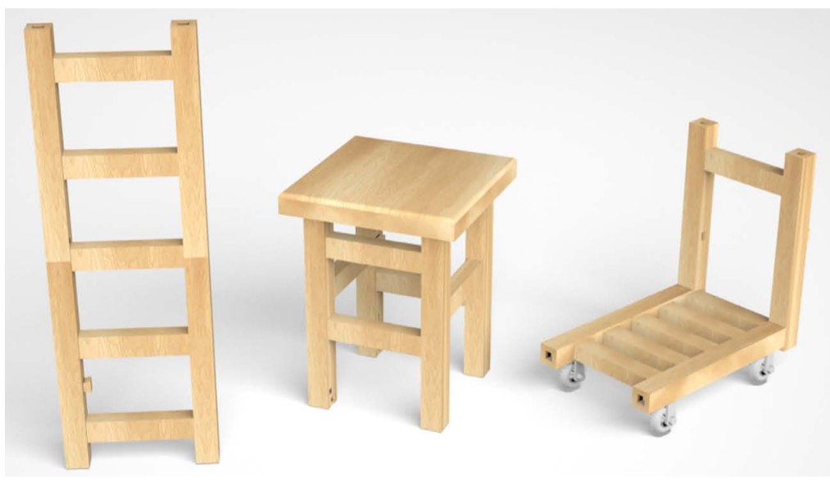
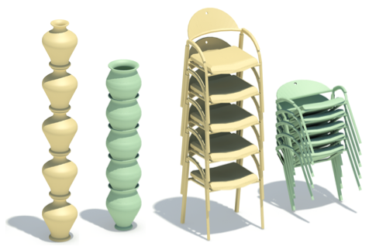
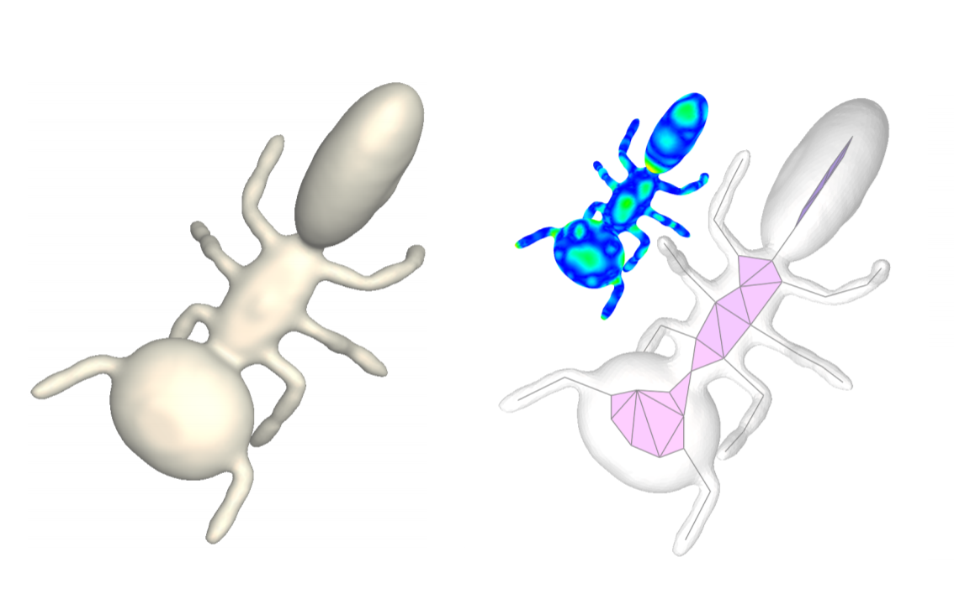
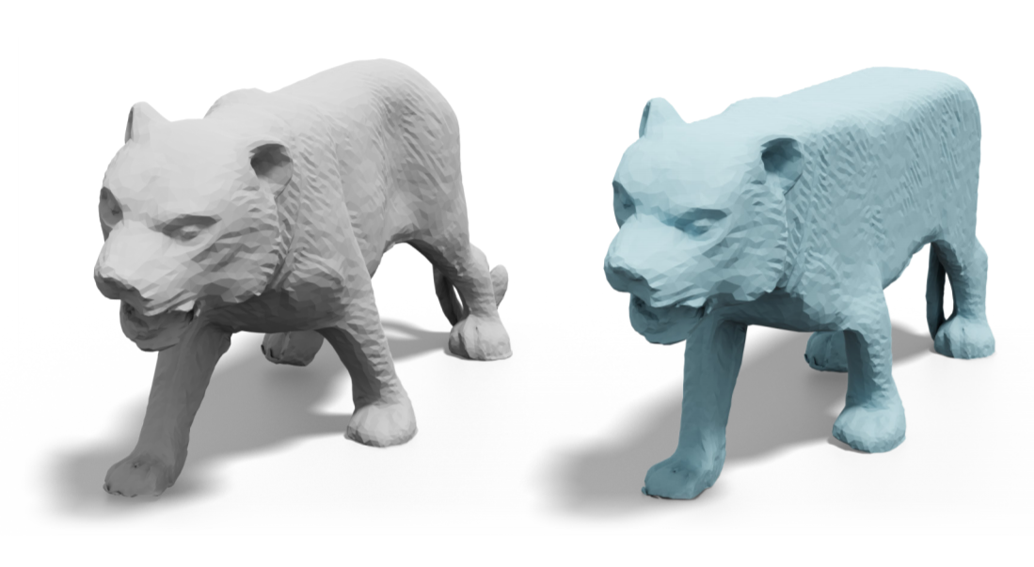
Shape transforms
[Kazhdan et al. 2013]
[Song et al. 2017]
[Li et al. 2012]
[Li et al. 2015]
[Liu et al. 2019]
Notes:
Shape transform is one of the most fundamental problem in computer graphics.

Slide 3
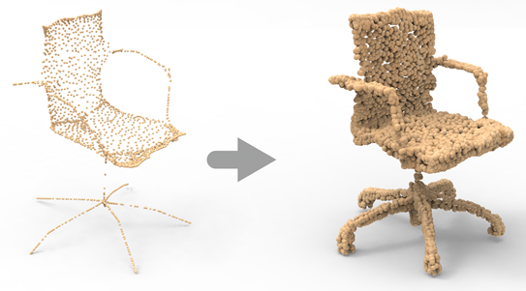
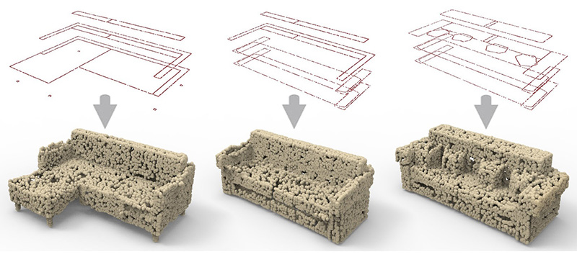
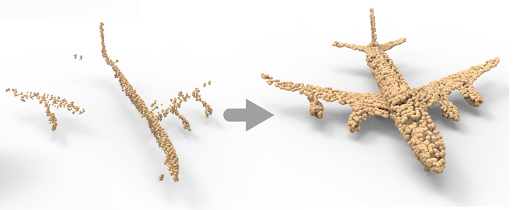
Learning shape transforms
skeleton → surface
Cross-sectional profiles → complete surface
P2P-NET [Yin et al. 2018]
Incomplete scan → complete surface
Notes:
Last year, at siggraph, we presented P2P-NET and showed that it can learn general-purpose shape transforms.
For examples, from skeleton to surface, or from cross-sectional profiles to complete surface.

Slide 4
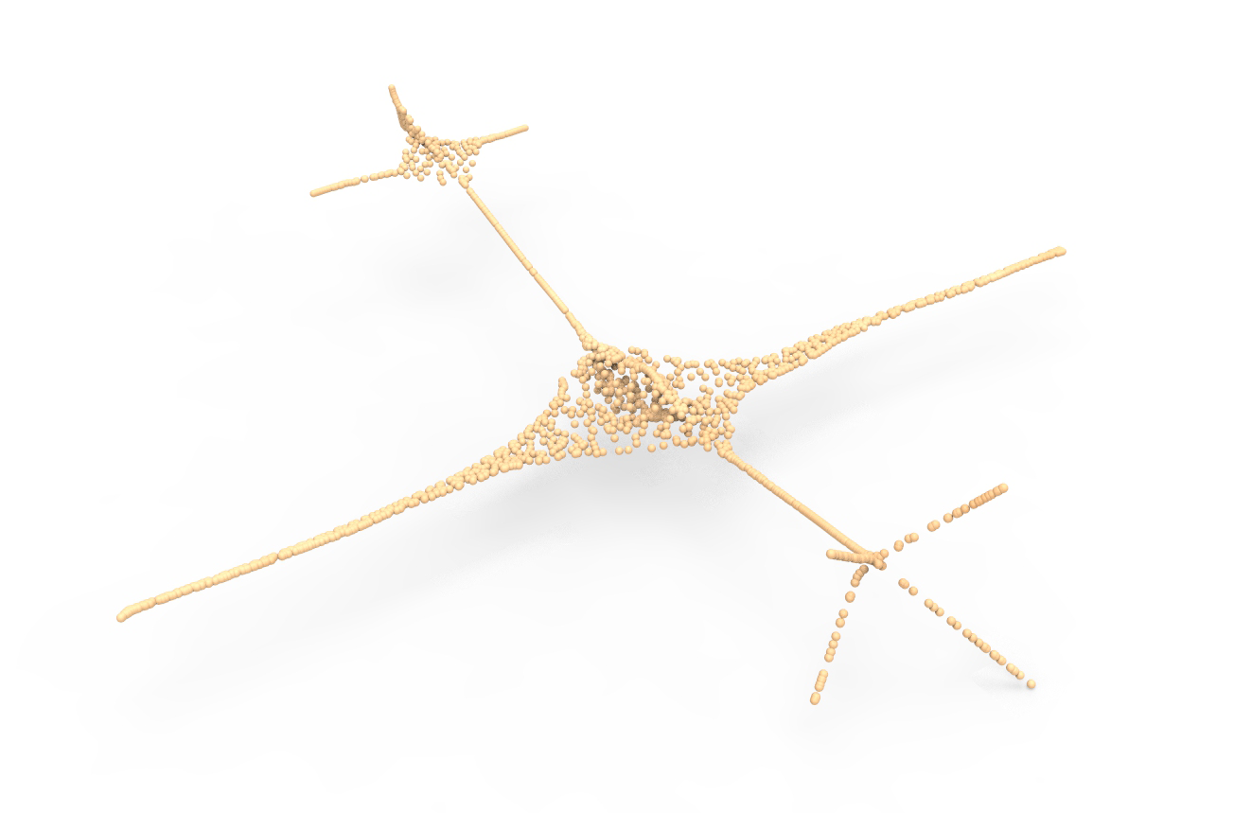
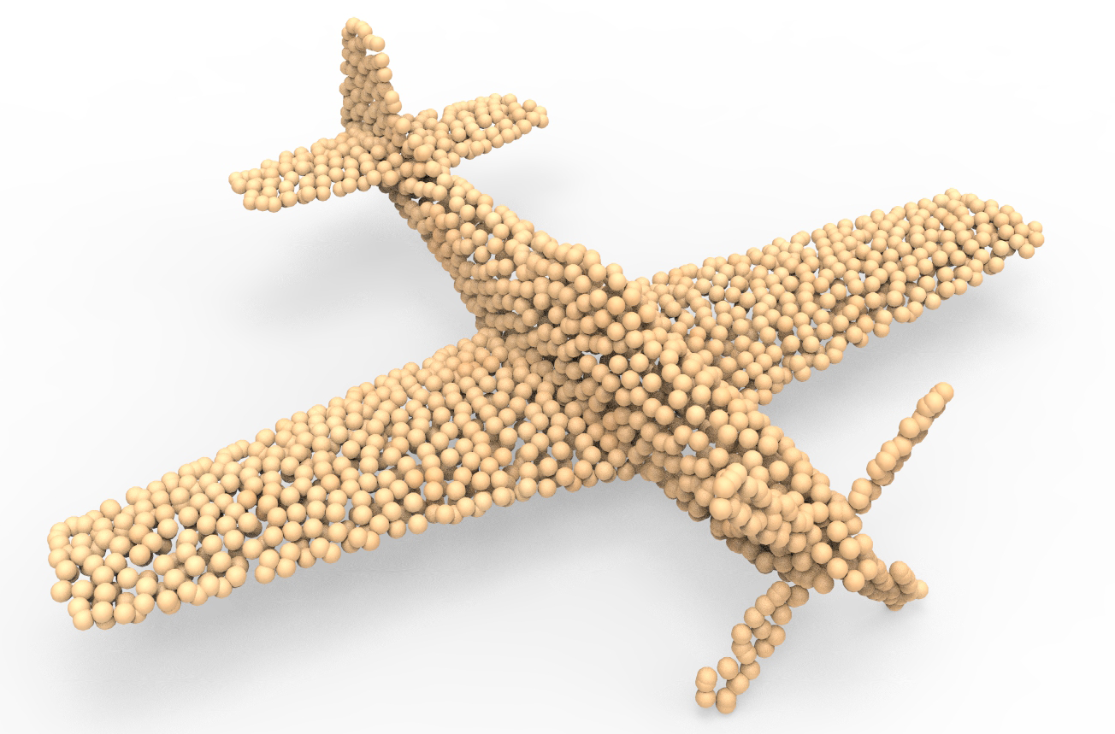
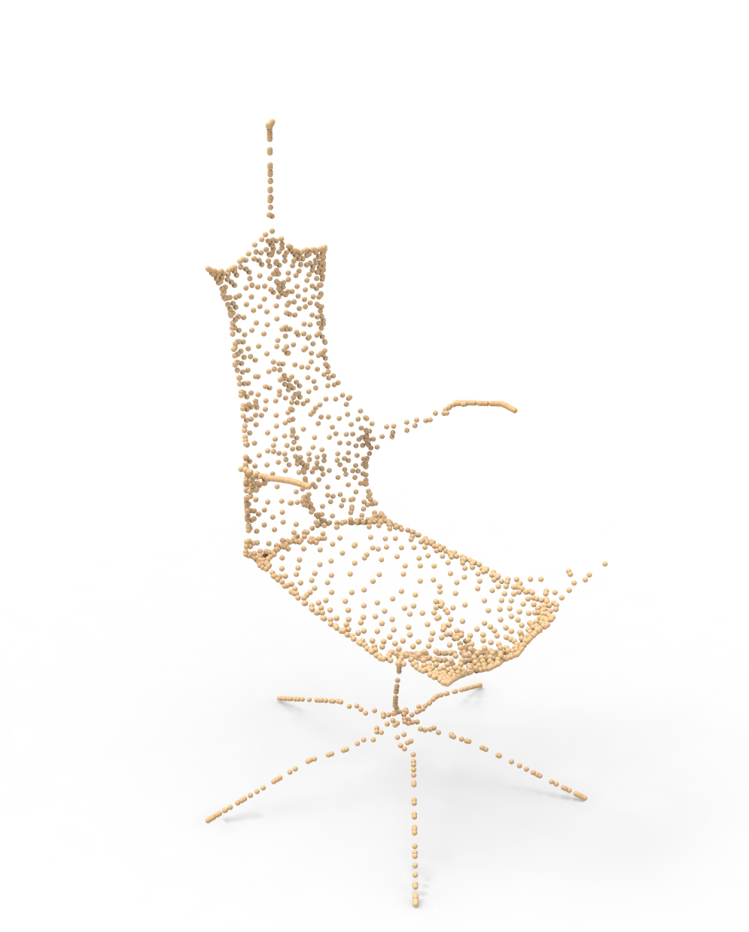
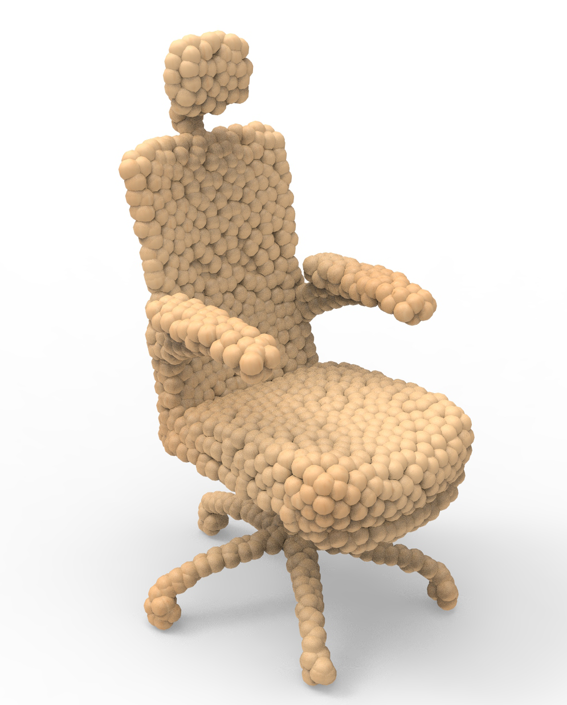
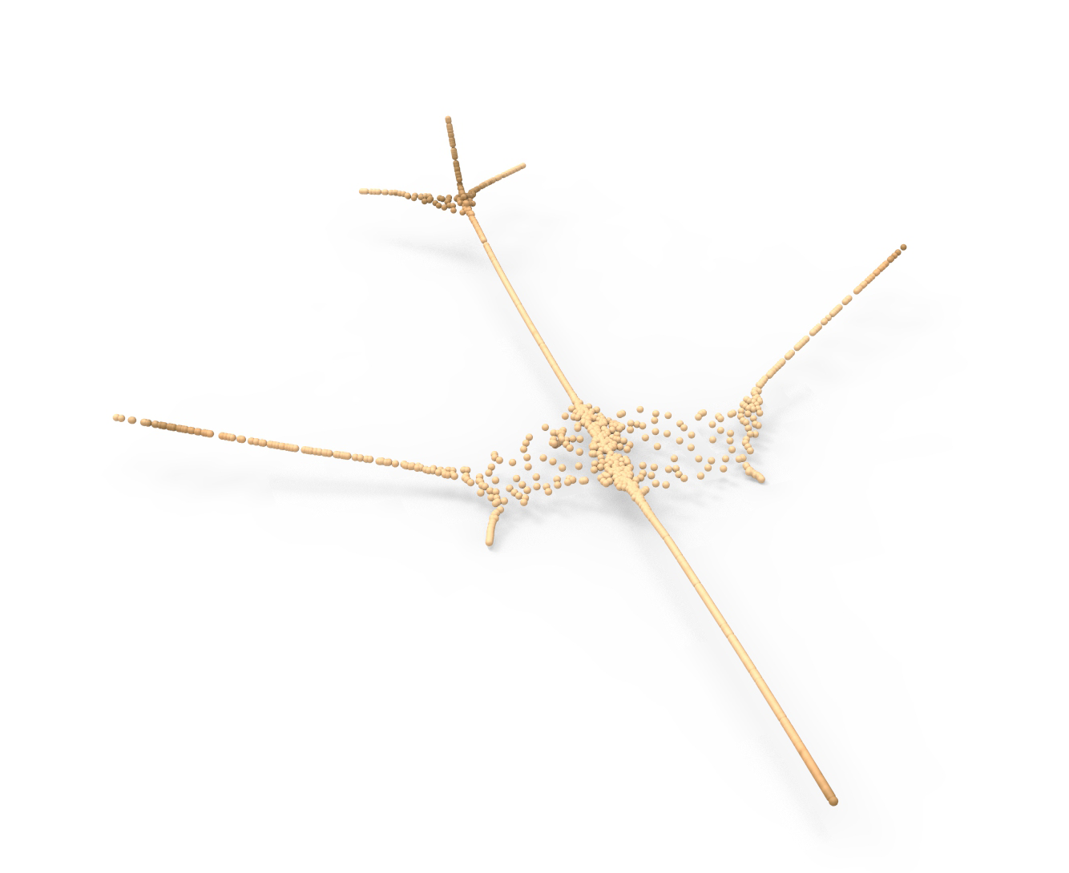
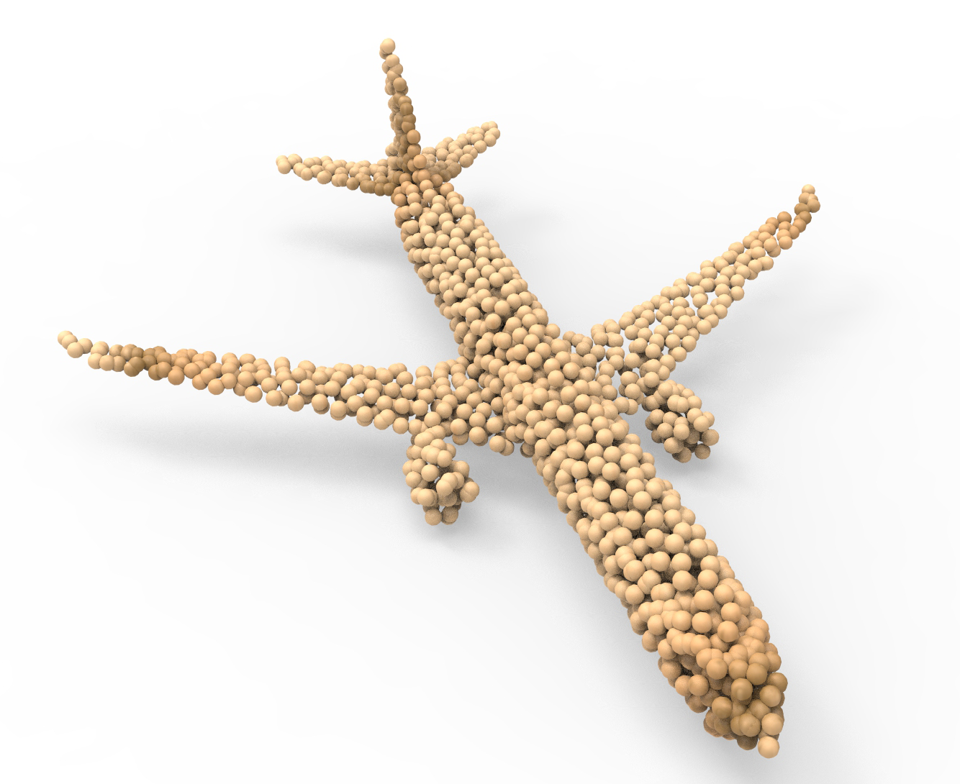
P2P-NET requires paired shapes
...
...
$$⋯$$
Domain A
Domain B
Paired shapes
Notes:
However, P2P-net is a supervised network; it requires paired shapes for training.
Here, it shows that each skeleton is paired with its ground-truth surface.
But paired shapes are not always available.

Slide 5
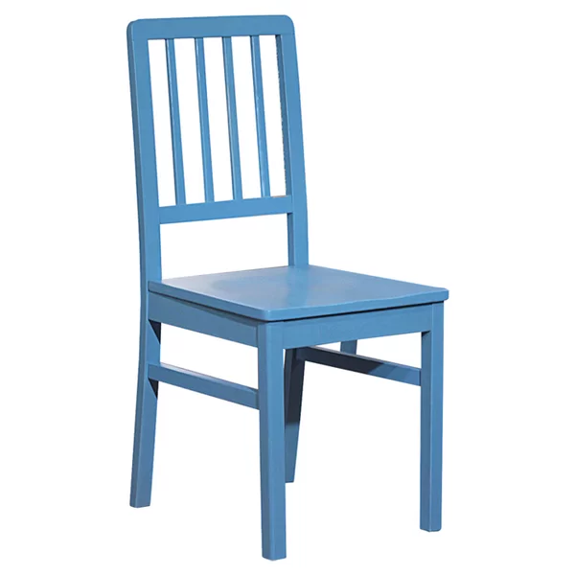
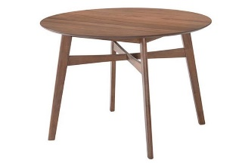
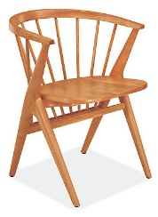
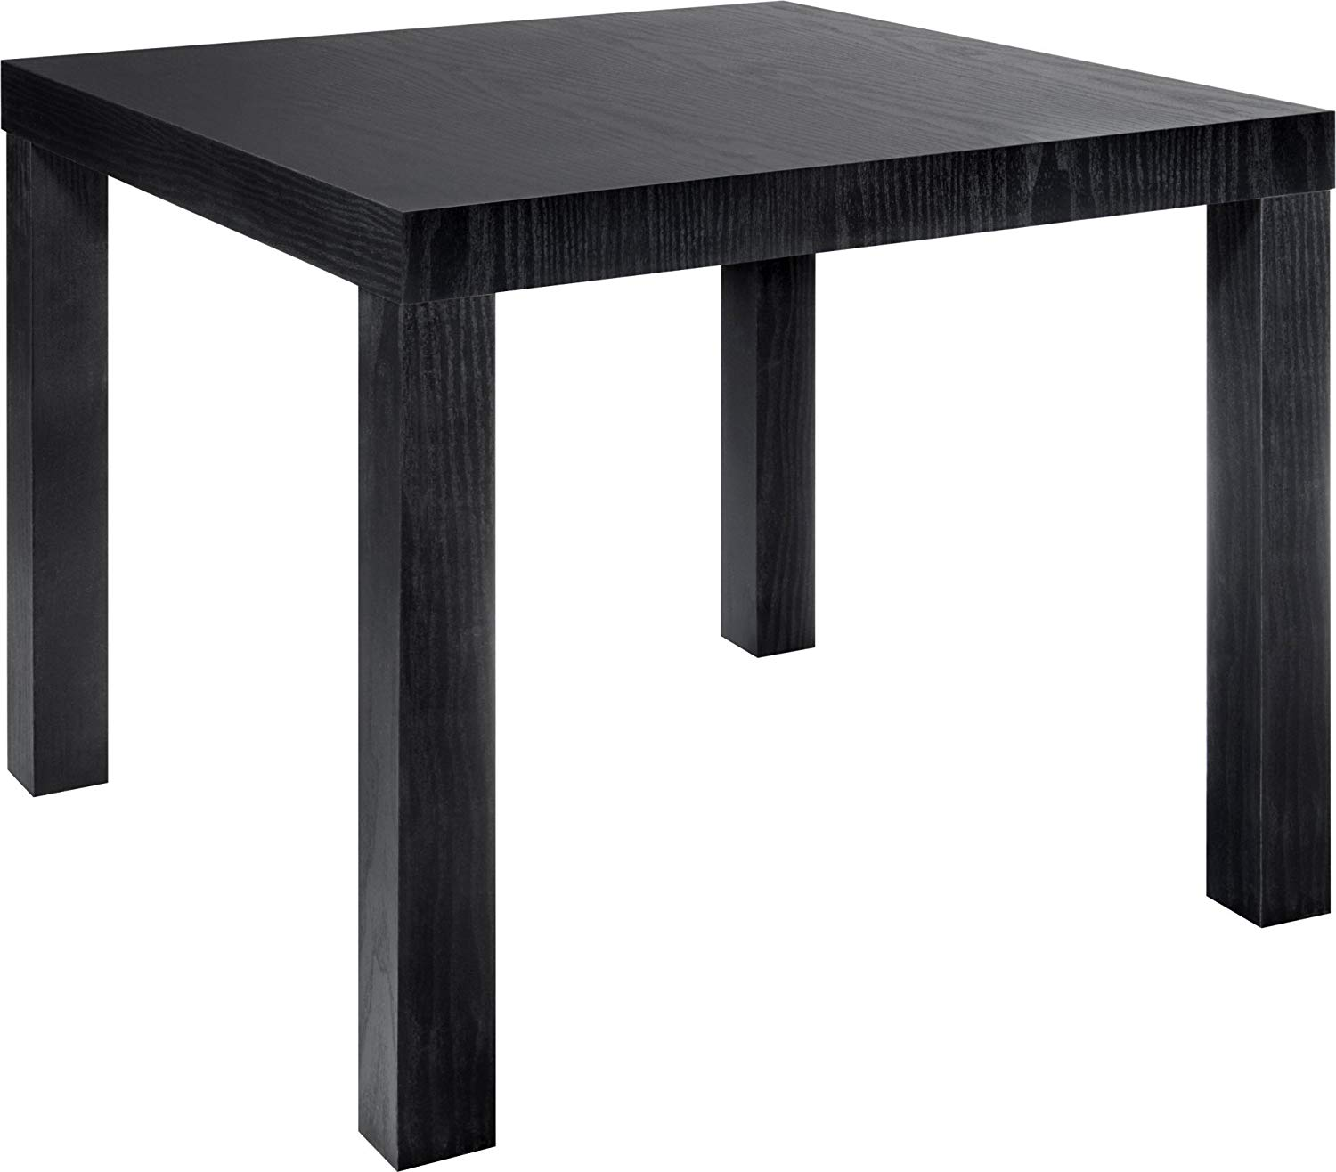
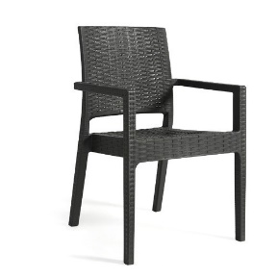
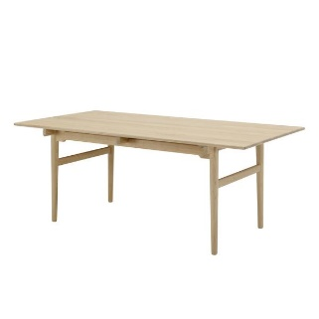
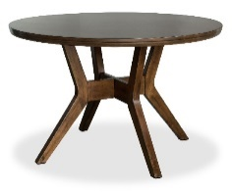
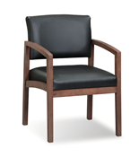
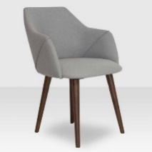
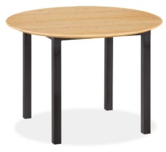
Unsupervised shape transform
Domain A
Domain B
Notes:
For example, when the goal is to learn a shape transform between chairs and tables.
There does not really exist a natural pairing relationship between two sets of objects.
We need a technique for learning shape transform without supervision,

Slide 6
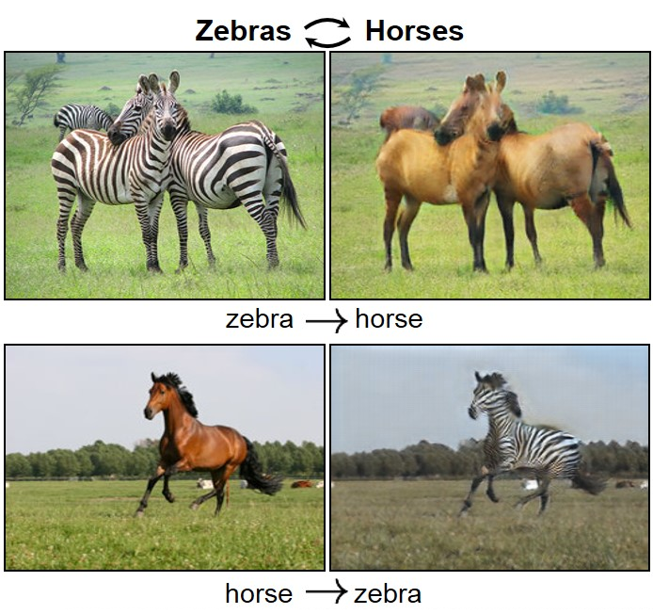
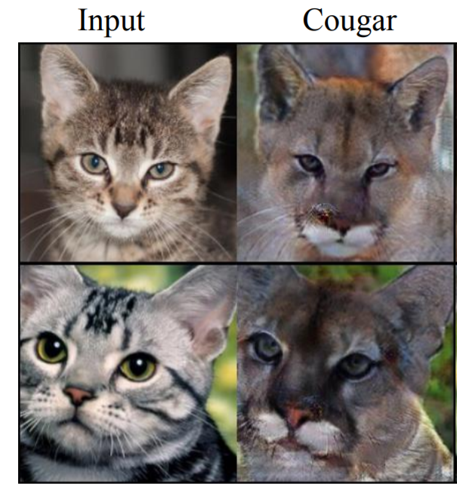
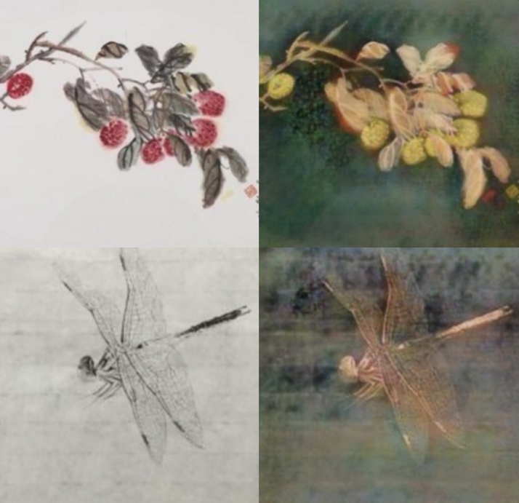
Unsupervised image-to-Image translation
Chinese painting Oil painting
DualGAN [Yi et at. 2017]
CycleGAN [Zhu et at. 2017]
UNIT [Liu et at. 2017]
Notes:
A similar problem in image domain is unsupervised image-to-image translation.
In unsupervised image translation, what is changed is usually the colors and textures, while shapes of objects are preserved.
That means there is not much geometric variation

Slide 7
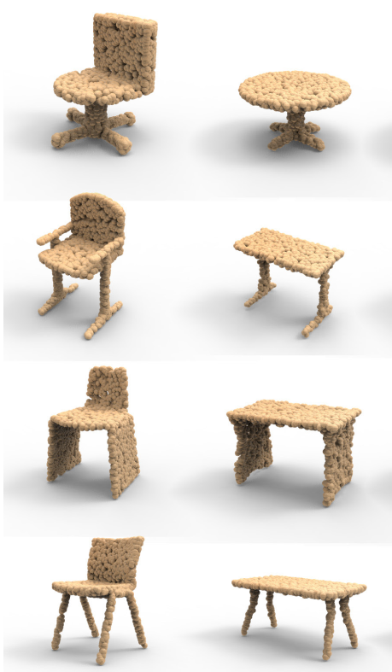
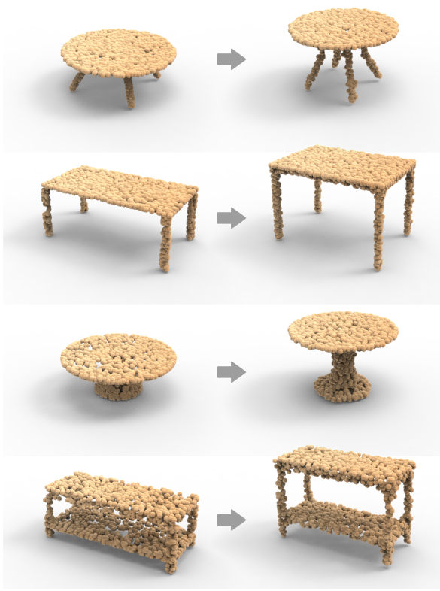
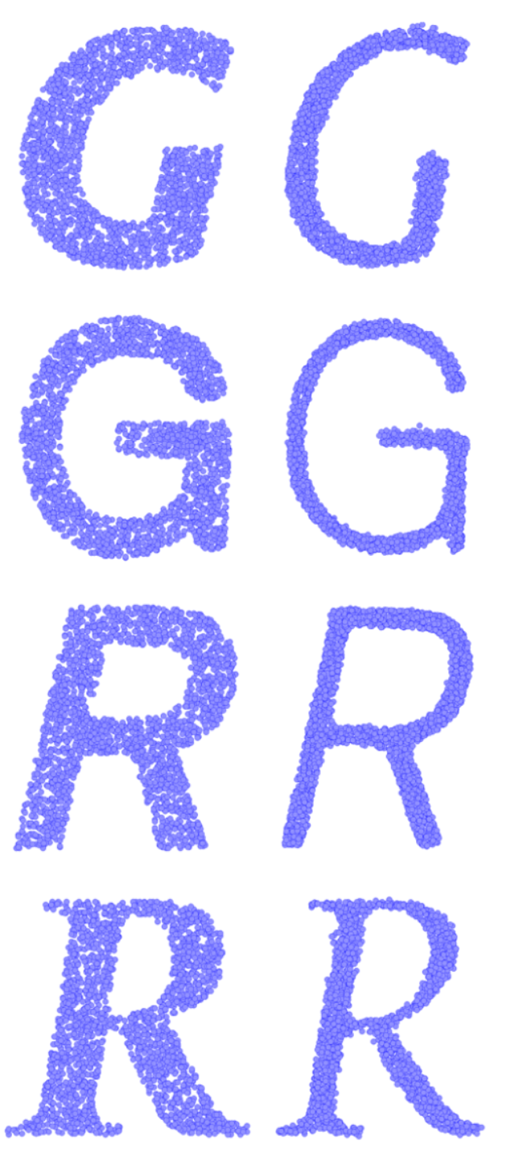
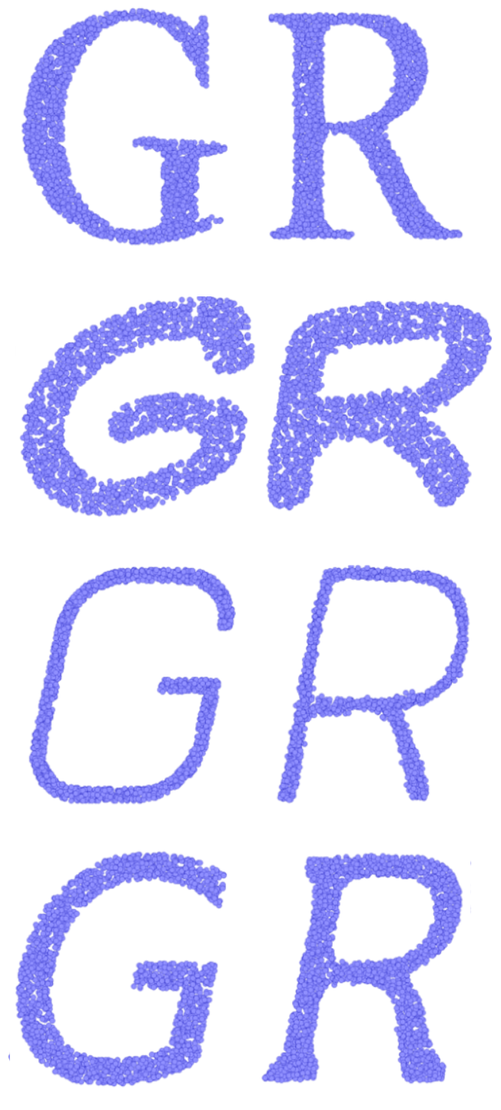
LOGAN
Chair → Table
Shor tables → tall tables
G → R
thick → thin
Notes:
In our work, we present LOGAN, an unsupervised neural network for learning general-purpose shape transform.
It can transform a chair into a similar table,
[click] or turn a short table into a tall table.
[click] It can learn to transform a letter G into a letter R, which is a content change, and the font style is preserved.
[click] It can also learn to transform thick letters into thin letters, which is a style change, and the content of the letters are preserved.

Slide 8
Unpaired shape transform
LOGAN = Latent Overcomplete GAN
LOGAN
Domain A
Domain B
Notes:
In shape-to-shape translation, it is not clear what are the shape features that need to be preserved, and what are the shape features that should be changed.
Our network, LOGAN, is designed to address this challenge.
[click] LOGAN is short for Latent Overcomplete GAN. It has two components.

Slide 9
LOGAN Component 1. Autoencoder
Domain A and B
Domain A and B
Notes:
The first component is a multi-scale autoencoder which encodes the two shape domains into the same common latent space which is overcomplete.
I will explain to you what do we mean by an overcomplete latent space a bit latter in this presentation.

Slide 10
LOGAN Component 2. Translator
Two loss terms compete!
Notes:
The second component is a GAN operating in the common latent space.
[click] It has an adversarial loss enforces cross-domain translation
[click] and a feature preservation loss ensures that the right shape features are preserved for a natural shape transform.
[click] The two loss terms actually complete with each other. One wants to change, another wants to preserve.
The competing result is that the shape features relevant to the target domain are preserved, and features not relevant to the target domain are changed.

Slide 11
Overcomplete common latent space
Notes:
Let’s first take a look at the details of the autoencoder.
[click] As shown here, the input shapes are represented by point clouds.
[click] We extract shape features in different scales and process and
[click] pool them into latent sub-vectors of size 64
[click] and pad them with zeros to make their lengths 256.
Each of the padded vectors and
[click] the concatenated overcomplete latent code are fed into the decoder.
[click] the decoder outputs the reconstructed point clouds

Slide 12
Overcomplete common latent space
Notes:
In the loss function,
[click] the first term sums up the EMD reconstruction errors for the 4 padded sub-vectors.
[click] The second term is the EMD reconstruction error for the overall latent code.

Slide 13
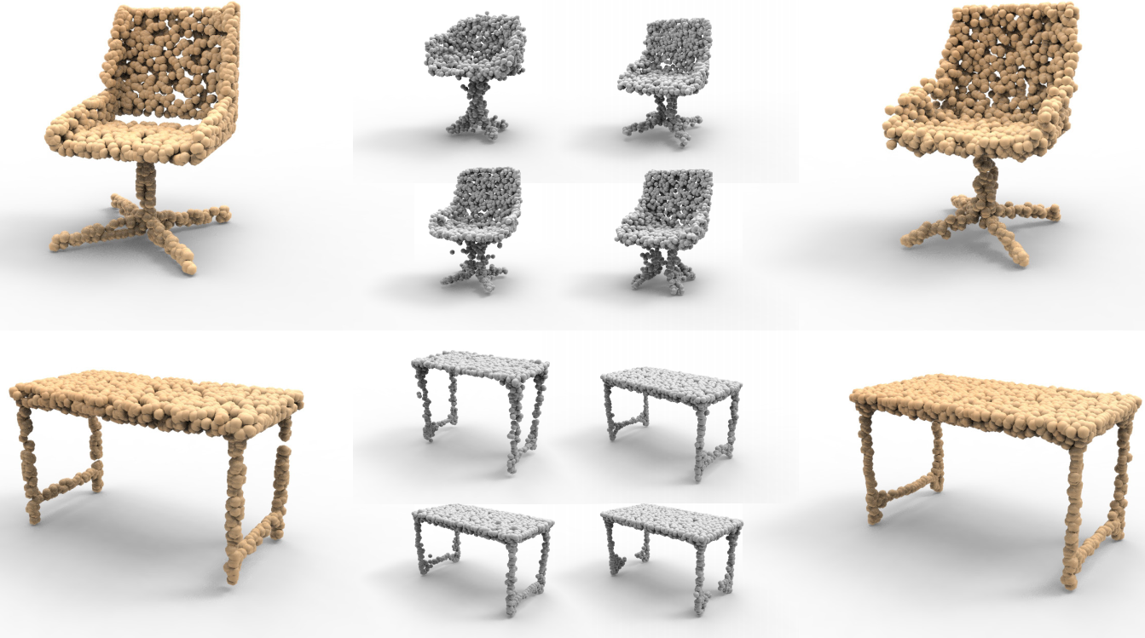
Overcomplete common latent space
Input
Reconstruction
from z₁ , z₂ , z₃ , z₄
Reconstruction
from z
Notes:
Here are the example input and output of the autoencoder.
[click] On the left, we show the input point cloud.
[click] In the middle, we show the reconstruction results from the four padded sub-vectors.
[click] On the right, we show the reconstruction result from the overcomplete latent code.
The decoder output for the overcomplete latent code shows better reconstruction quality than those from the padded sub-vectors.
But, all the reconstructions resemble the input shapes well. Each sub-vector itself has enough information for reconstructing the whole shape.
This demonstrates the overcompleteness of our latent codes. It will provide more degrees of freedom for the translator network to operate with.

Slide 14
Translator
Notes:
The translator network itself is built on a Wasserstein GAN. Taking the chair-table translation for example,
[click] during training, we feed a batch of a chairs to the translator
and want it to output [click] a batch of tables, under the guidance of the adversarial loss..
Meanwhile, [click] we also feed a batch of tables to the translator and ask it to [click] output the same tables.
This is done by enforcing a feature preservation loss here. 【click】
The feature preservation loss is defined as L1 distance between the code before translation and after translation.
[click] Here is the loss function for the translation from X to Y.
[click] The first term includes the adversarial loss and gradient penalty loss in WGAN.
[click] The second loss term is the feature preservation loss.

Slide 15
Translator
Notes:
Of course, we can also add a cycle loss when we train the two directions of transforms together.

Slide 16
Ablation study of translation loss terms
Input
WGAN + Cycle
WGAN + FP
WGAN + FP + Cycle
Notes:
Here, we show a single example to demonstrate how different combinations of loss terms influence the translation result.
【click】Here, on the left, we show the input.
【click】If we only combine WGAN with a cycle loss, it doesn’t provide meaningful output.
【click】However， combining WGAN with our feature preservation loss can give reasonable result.
【click】Adding a cycle loss to them can further improve the quality of the result.

Slide 17
Visualization: Latent code preservation/alteration
Orange bars: dimensions with largest changes.
Blue bars: dimensions with smallest code changes.
Notes:
Our translator, working with our overcomplete autoencoder, can facilitate an implicit disentanglement of the preserved and altered shape features.
To examine this,
[click] we plot latent code dimensions with the largest changes with orange bars,
[click] and plot latent dimensions with smallest changes with blue bars.
We can observe that our network automatically learns the right features to preserve.
[click] E.g., more coarser-scale features are preserved for the transform from skeleton to surface
[click] and more local features are preserved for letter transform from G to R.
[click] For the translation from chair to table, coarse-level and fine-level features are both important. So some of them are preserved and some of them are changed.

Slide 18
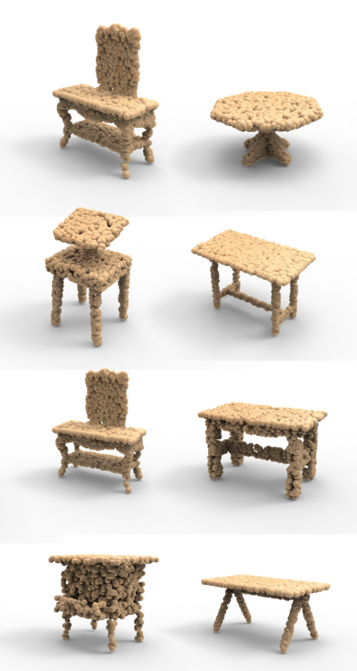
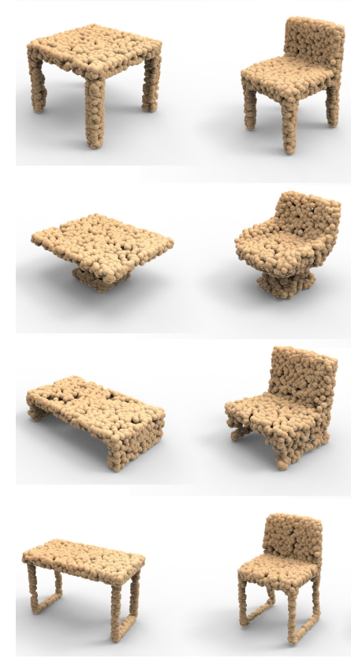
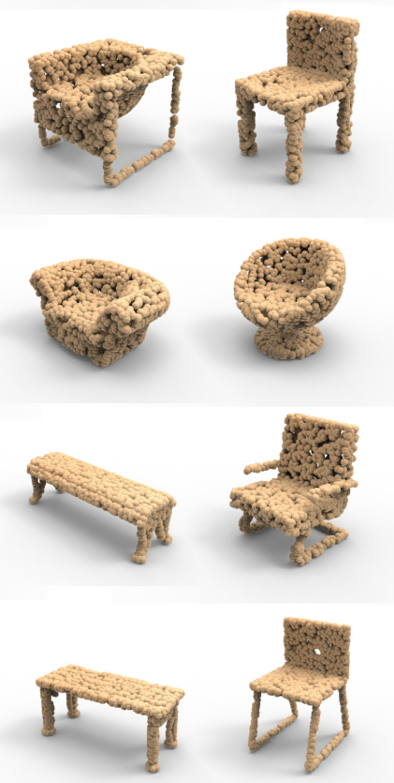
Result: Table ↔ Chair
retrieved closest training shapes
retrieved closest training shapes
input chair output table
input table output chair
Notes:
Ok. Let’s see some results.
Here we show the translation results from chairs to tables.
【click】 The first column shows the input chairs,【click】 and the second column shows the output tables.
We can see that they are quite similar in terms of leg styles . And the styles between chair seats and table tops are also very similar.
【click】 Here we show that simply retrieving a table from the training set for the input chair won’t give reasonable results.
【click】 We also show the retrieval result for the output table. It shows that there are no exactly the same tables in the training set.
【click】 here is the results for the other direction, i.e., from tables to chairs.
【click】 and we can get the same conclusions from the retrieval results.

Slide 19
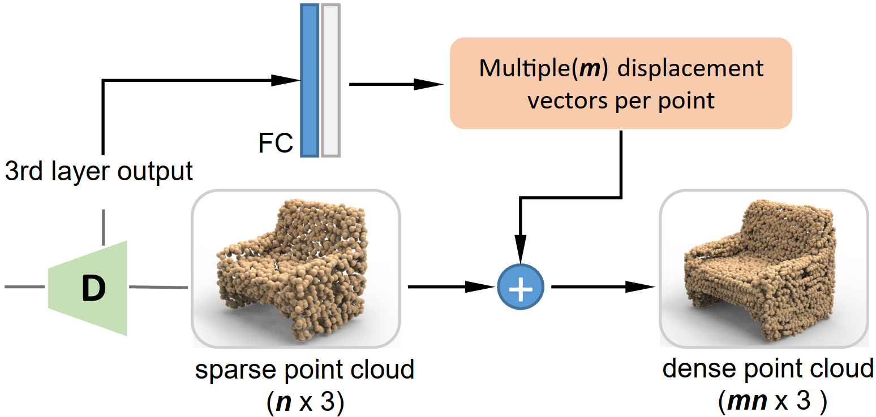
Upsampling
Notes:
After we transform chairs into tables,
we can upsample the output point clouds in a manner similar to p2p-net.
[click] Here we take the output of the 3rd layer of the decoder,
[click] and feed it to a fully connected layer.
[click] the fully connected layer predicts m displacement vectors for each point.
[click] After we apply the displacement vectors to the output point cloud of size n, we can a get dense point cloud of size m times n

Slide 20
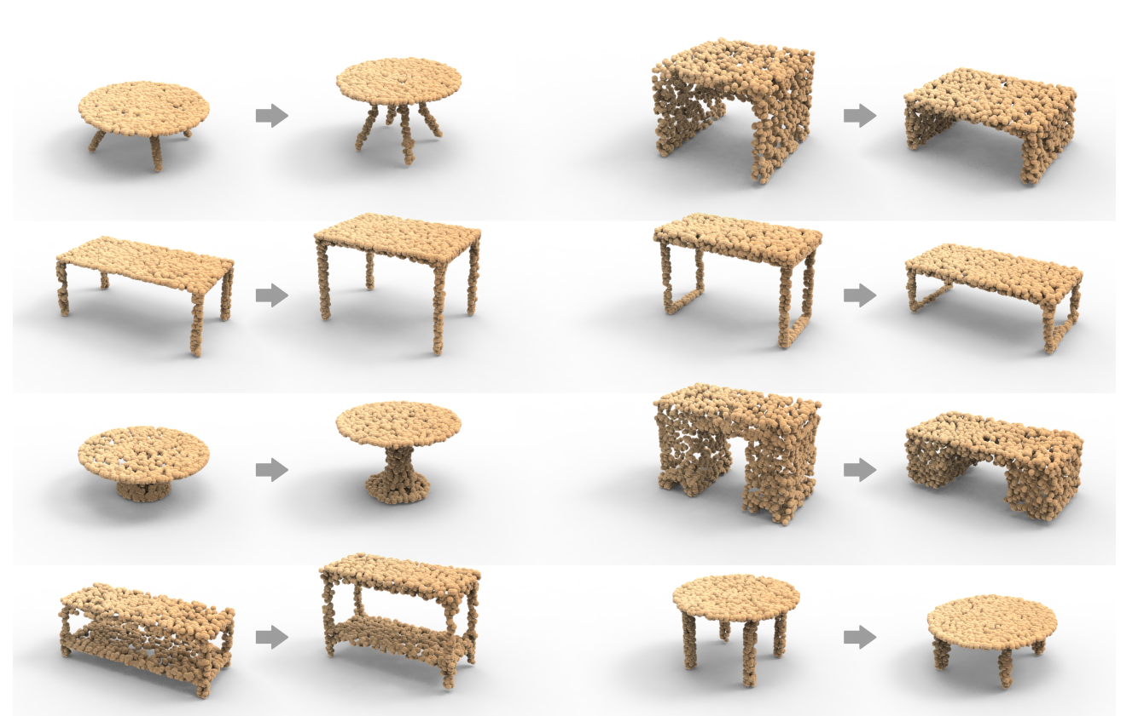
Result: Tall Table ↔ Short Tale
Short Tall
Tall Short
Notes:
Our network can also learn to change the attributes of 3D objects.
[click] For example we can turn short tables into tall tables, after trained under the two input domains.
[click] Of course, we can also turn tall tables into short tables.

Slide 21
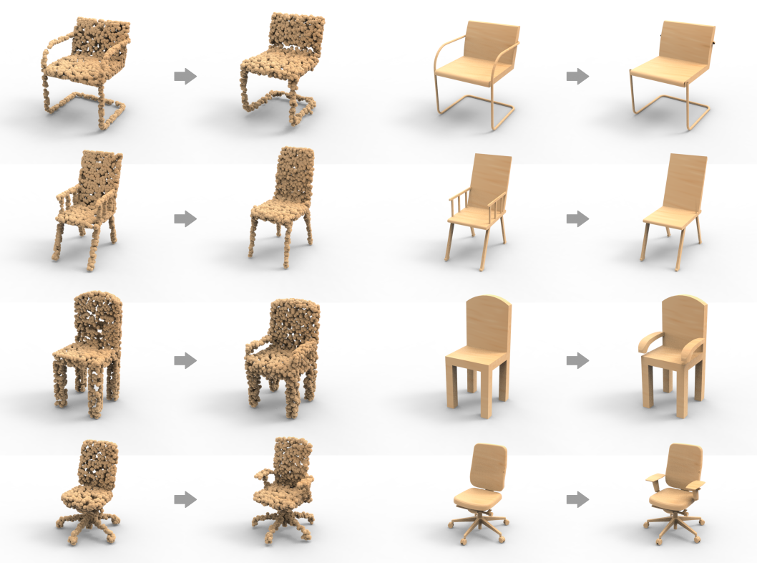
Result: armchair ↔ armless chair
Notes:
Here we show that our network can learn to
[click] remove parts from 3D objects.
[click] Or, add parts to 3D objects.
[click] The user can then get mesh editing results according to the transforms of the point clouds.

Slide 22
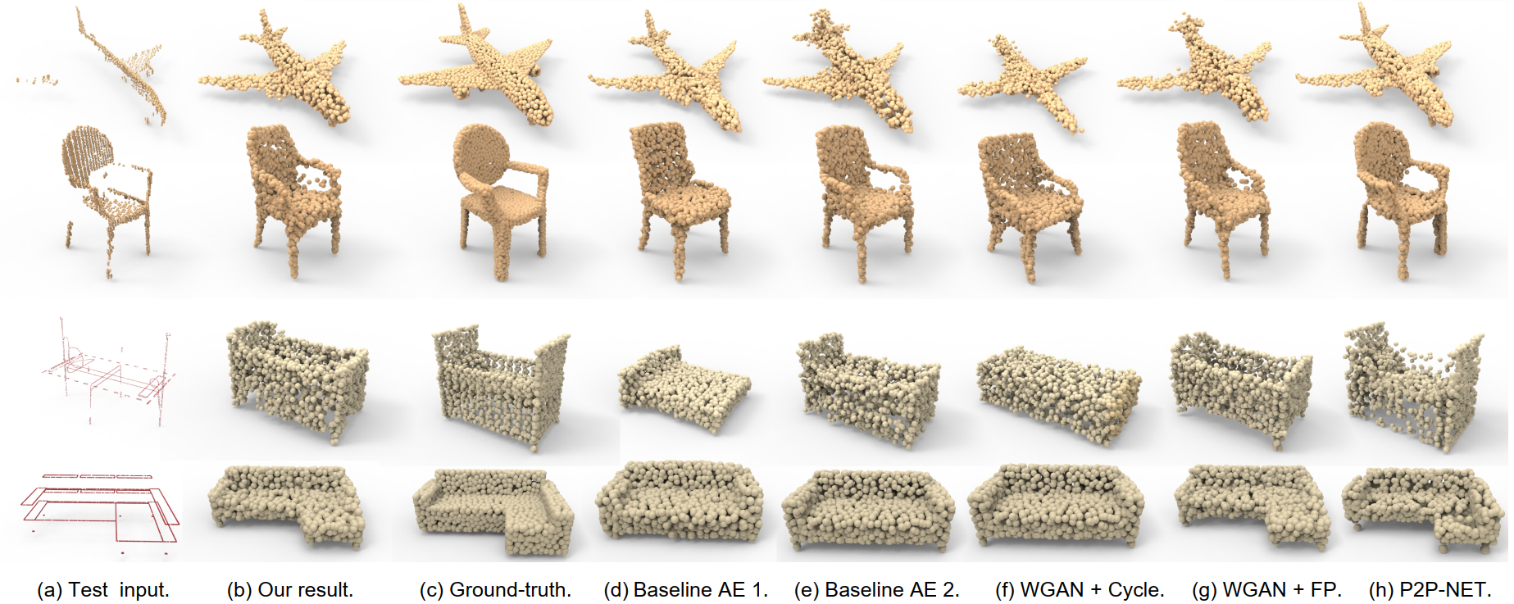
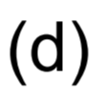
Ablation study on datasets of P2P-NET
Notes:
We don’t have ground truth for the chair and table datasets. But we do have ground-truth in the datasest of P2P-net.
With the datasets of P2P-Net, we can compare our results with different network configurations and baselines.

Slide 23
Ablation study and comparison to baselines
Notes:
The quantitive evaluation results show that our default network configuration produces most satisfactory results.

Slide 24
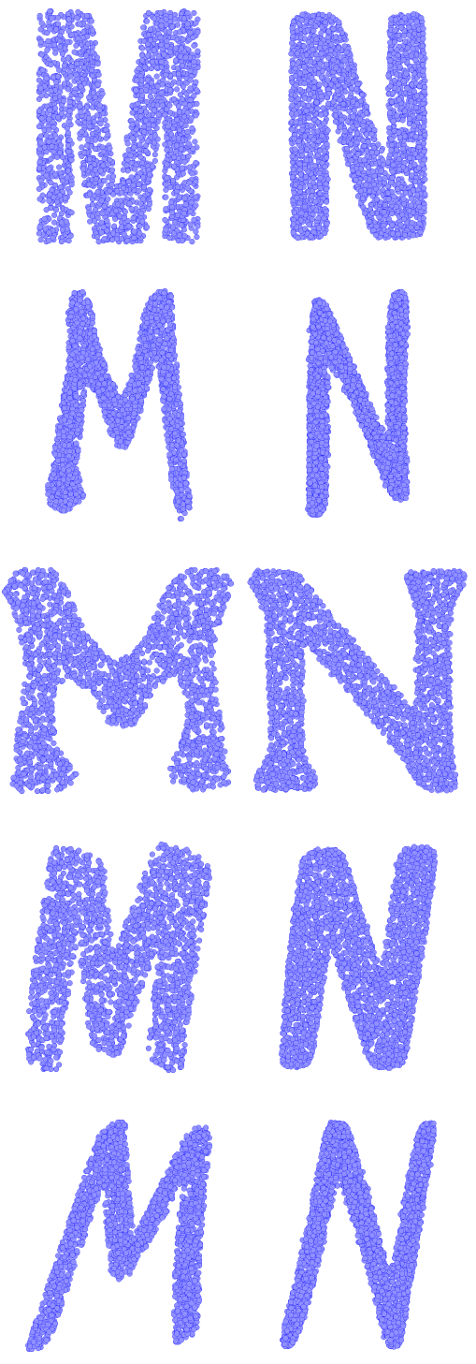
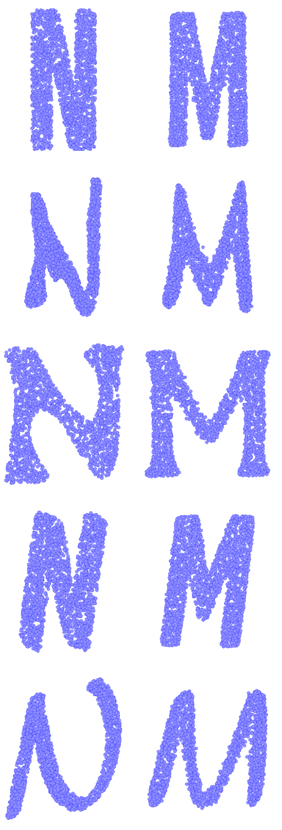
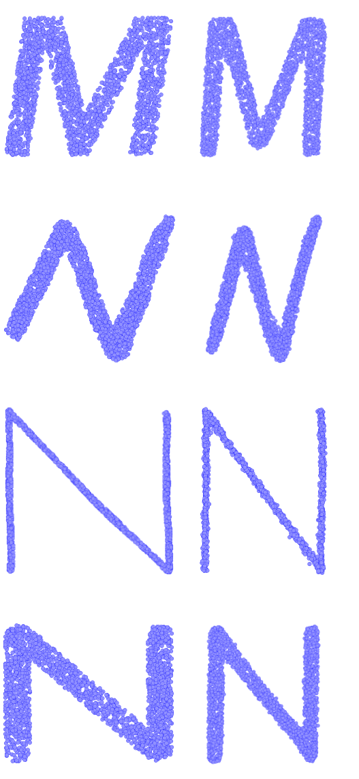
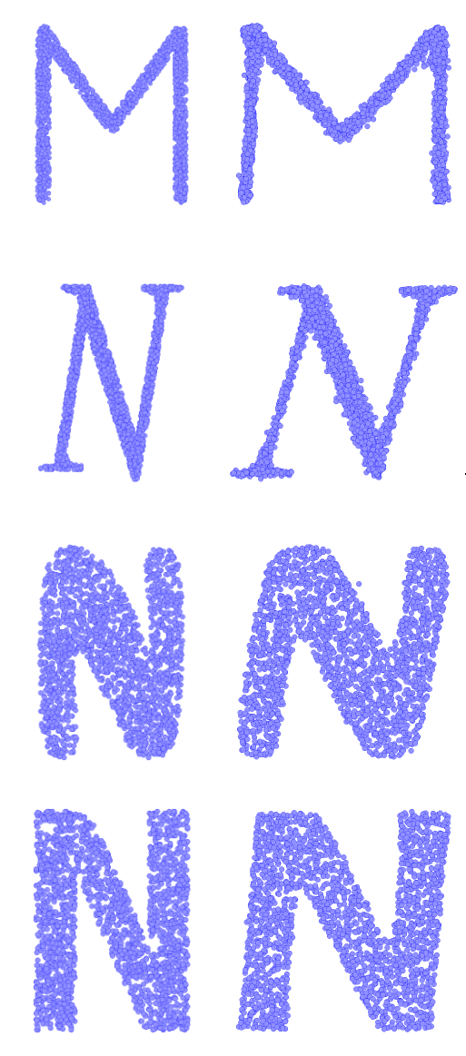
Either content transfer or style transfer…
M → N
N → M
wide → narrow
narrow → wide
Notes:
As mentioned before, depending solely on the input unpaired training domains, our network can learn both content transfer and style transfer.
Here we show another set of examples.
[click] On the left, we show content transfer from from M to N, and from N to M.
[click] On the right, we show style transfer from wide fonts to narrow fonts, and from narrow fonts to wide fonts.

Slide 25
LOGAN vs. image translation networks
thin → thick
wide → narrow
Notes:
We converted our point cloud results into images
and compare our results with unsupervised image translation networks, including CycleGAN, UNIT and MUNIT.
Here we show the results for style transfer.
[click] For thin to thick transform, the results of the 4 networks are similarly good.
[click] However, for wide to narrow transform, the image translation networks failed to give reasonable results,
that is probably because they don’t have a global understanding of the shape of the input letter.

Slide 26
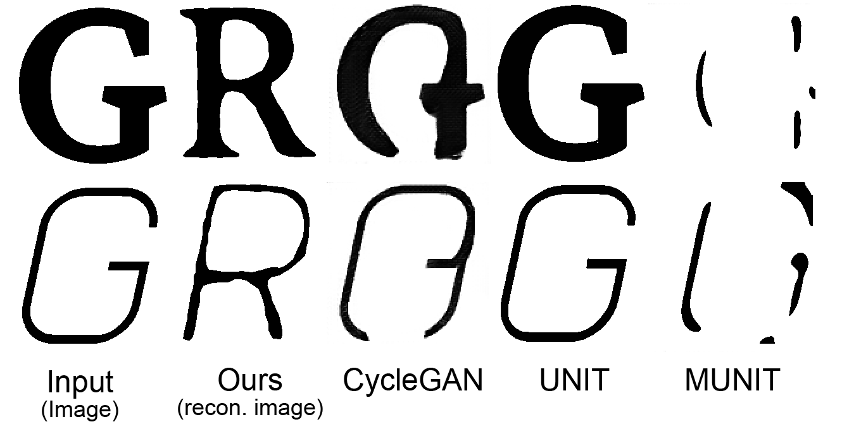
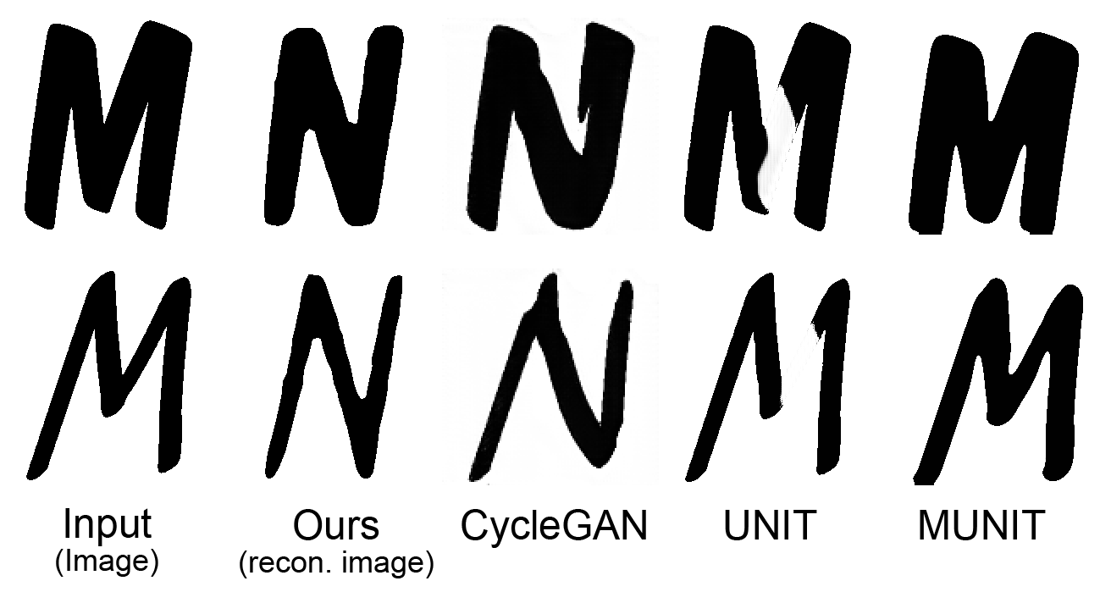
LOGAN vs. image translation networks
G → R
M → N
Notes:
Here are the visual comparison for content transfer
.
Note that we have ground-truth for font content transfer

Slide 27
LOGAN vs. image translation networks
Notes:
With the ground-truth, we computed MSE and IOU for the whole test sets.
These numbers show that our network produces the best results.

Slide 28
Conclusion
Chair → Table
Shor tables → tall tables
G → R
thick → thin
Notes:
To conclude, we have presented LOGAN, an unsupervised network for general-purpose shape transform.
It is robust and adapt well to different transformation tasks.

Slide 29
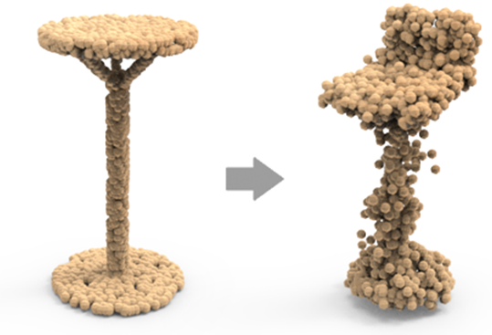
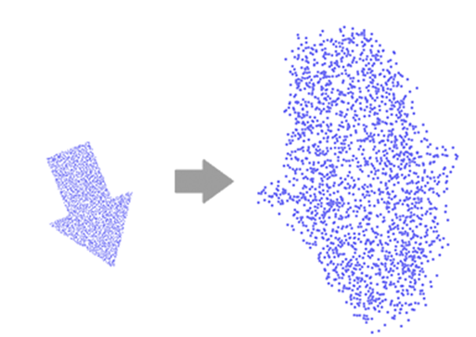
Limitation
(a)
(b)
Notes:
Of course, our network has its limitations.
One limitation is that, due to the nature of point cloud representations, the output shapes are not necessarily clean or compact.
Second, our method assumes a “scale-wise alignment” between the input shapes.
On the right. we show a result from LOGAN which was trained to transform a small arrow into a large arrow.
the result is unnatural because of lack of scale-wise alignment.

Slide 30
Thank you!
LOGAN:
Unpaired Shape Transform in Latent Overcomplete Space
Code and data are available: https://github.com/kangxue/LOGAN
Notes:
Ok, this is the end of the presentation.
Code and data of this work has been released on GitHub. Welcome to have a try.
Btw, [click] the letters here actually show a puzzle. If you change the order of them, you will find that they actually can form exactly the two words “siggraph asia”.
Thanks for your attention.

